Slide 1
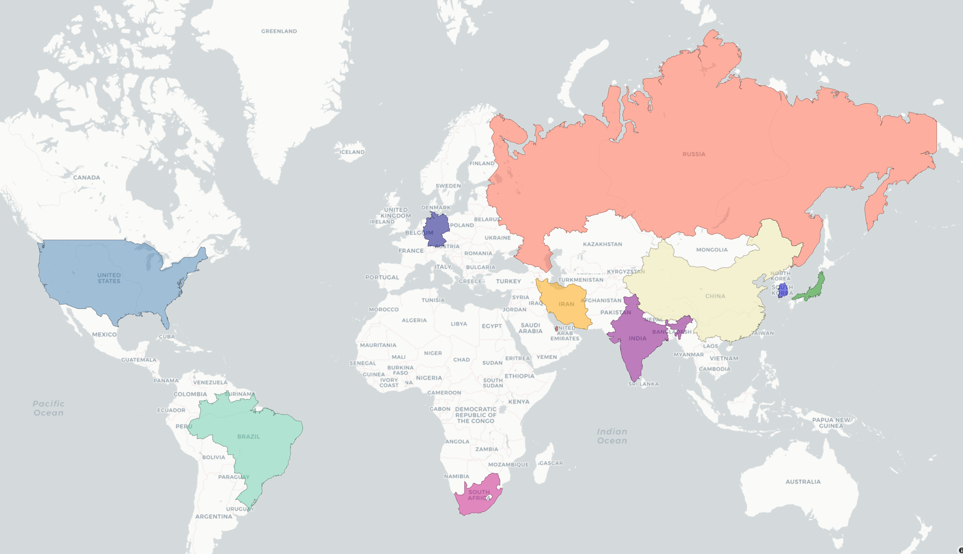

Confrontative,
Not
Representative!
What the World‘s Media Reported
in Summer 2023
BRICS
The West
Data Science Project by Thomas Haberichter presented August 22, 2023 at SPICED Academy
The Rest
TASS
Deutsche Welle
Fox News
Xinhua
pressTV
Iran
The Asahi Shimbun
Al Jazeera Bahrain
Yonhap
News Agency
The Rio Times
The Hindu
News 24

Slide 2

What is Topic Analysis?
>4,600 news articles
from 11 sites collected between July 24 and August 14

Slide 3
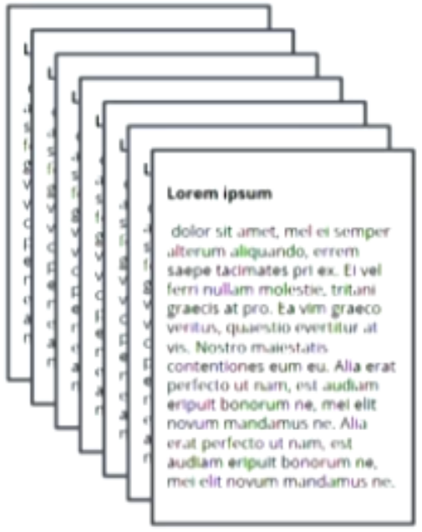
What is Topic Analysis?
1)
extract texts
and meta data
>4,600 news articles
from 11 sites collected between July 24 and August 14
Source | Date | Title
Asahi Shimbun | 2023-08-15 | Yoon says summit with U.S., Japan a milestone in trilateral ties..
The Rio Times | 2023-07-30 | Study reveals unreliability of U.S. climate data: 96% rated as inadequate
TASS | 2023-07-25 | Twitter's official corporate account on social media platform renamed ‘X…
Deutsche Welle | 2023-07-25 | Ecuador declares state of emergency in prisons amid gang war. Ecuador’s…

Slide 4
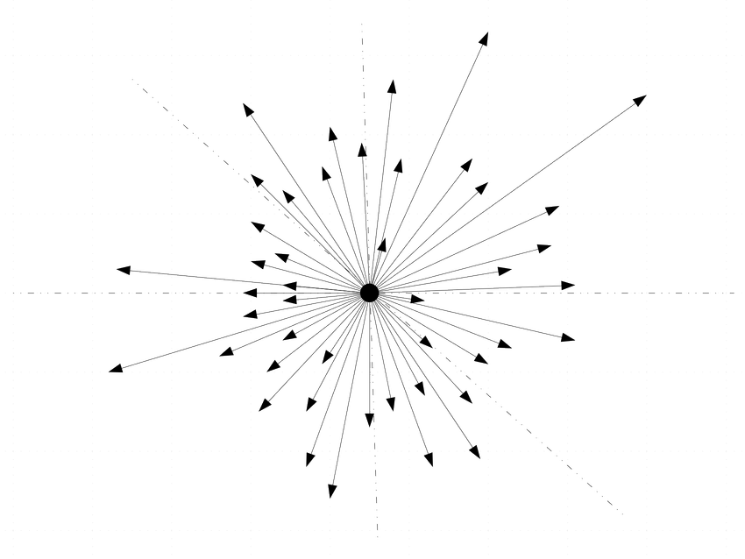
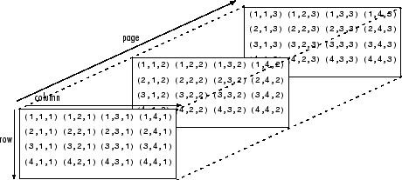
What is Topic Analysis?
2)
embed / vectorize
Source | Date | Title
Asahi Shimbun | 2023-08-15 | Yoon says summit with U.S., Japan a milestone in trilateral ties..
The Rio Times | 2023-07-30 | Study reveals unreliability of U.S. climate data: 96% rated as inadequate
TASS | 2023-07-25 | Twitter's official corporate account on social media platform renamed ‘X…
Deutsche Welle | 2023-07-25 | Ecuador declares state of emergency in prisons amid gang war. Ecuador’s…

Slide 5
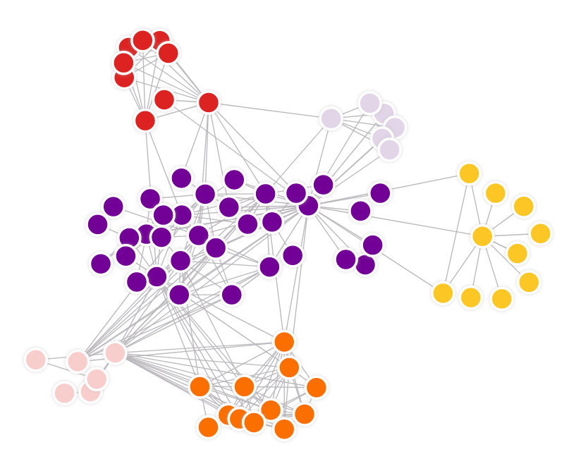
What is Topic Analysis?
3)
cluster

Slide 6
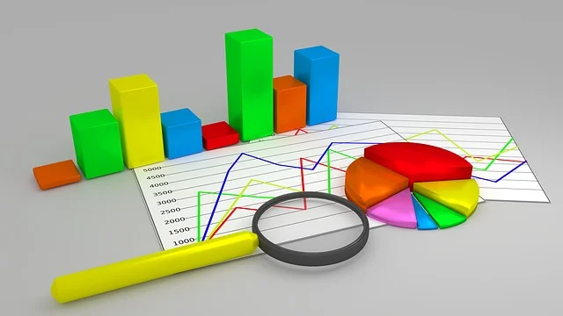
What is Topic Analysis?
4)
extract information
evaluate
analyze

Slide 7
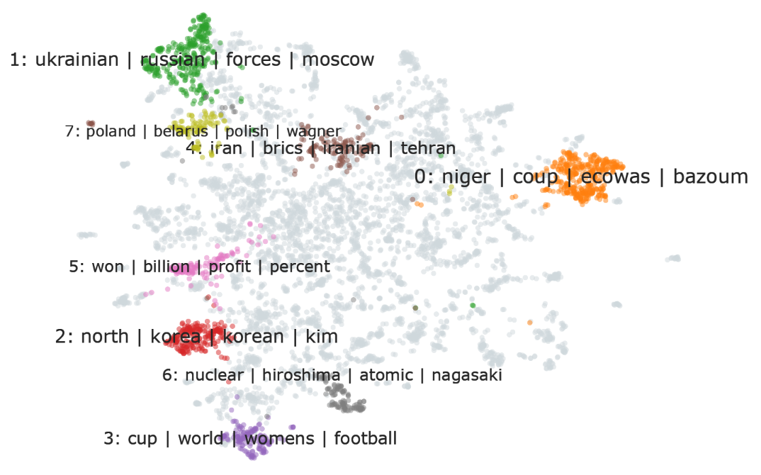
The World’s Topics
In Summer 2023
For interactive version → http://www.thabe.de/DS/WorldNews_2023.html

Slide 8
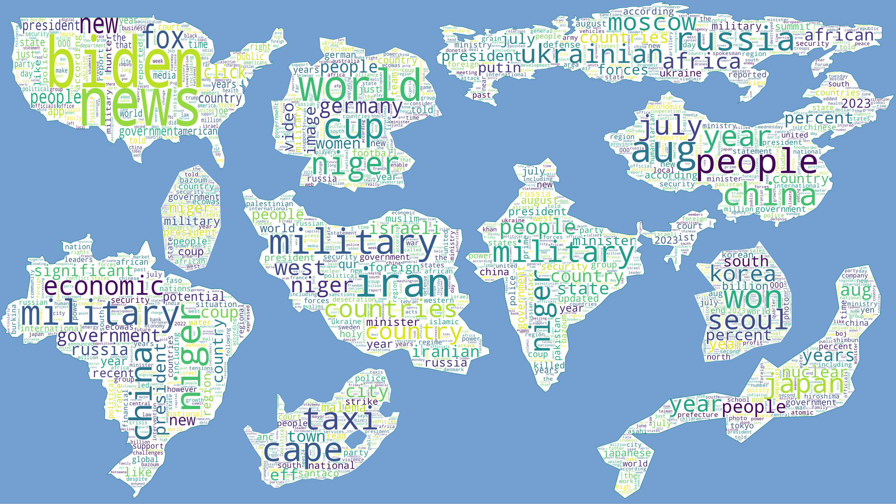
Top Three Topics per Source

Slide 9
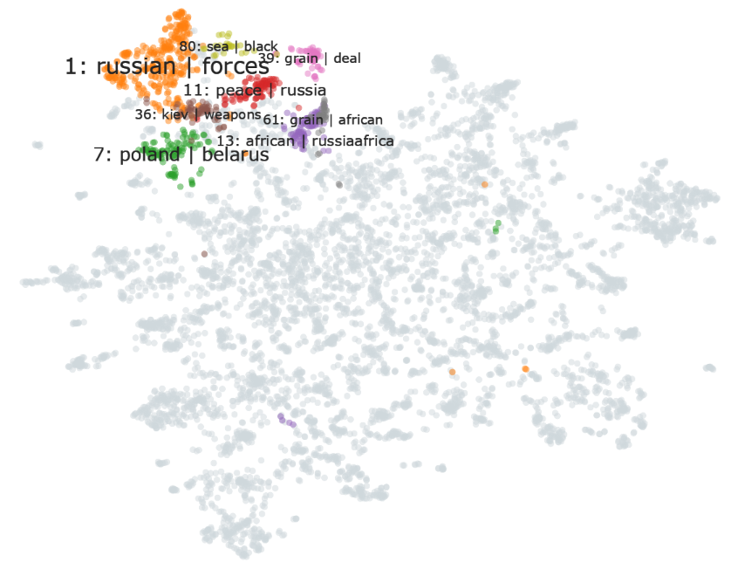
Ukraine-related
Topics
312 news articles
re-cluster

Slide 10
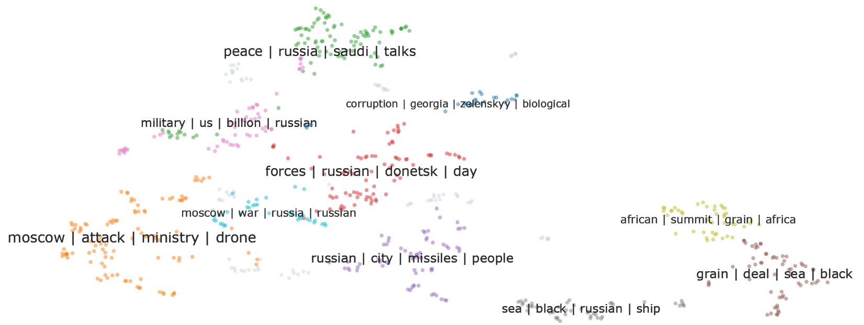
Ukraine-related Topics
re-clustered

Slide 11
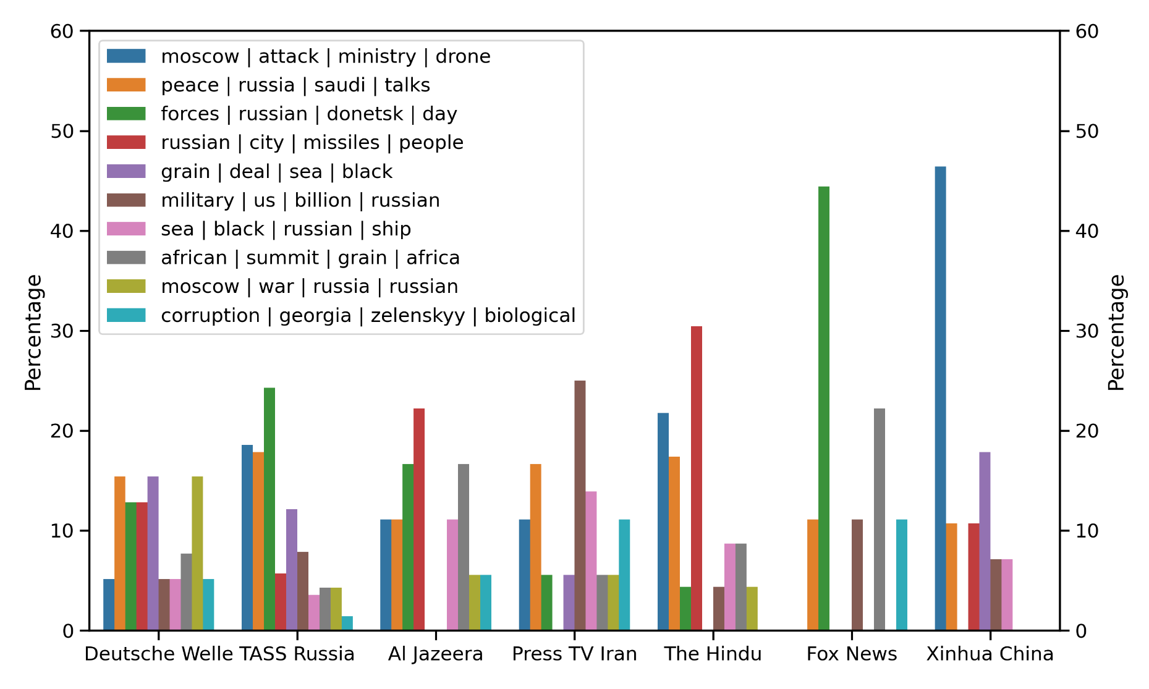
Ukraine: Who covers what
less balanced coverage of fewer topics
balanced coverage of multiple topics

Slide 12
Ukraine: Who covers what
49% of Xinhua‘s Ukraine coverage
= drone attack on Moscow

Slide 13
More to Explore
How do topics evolve over time (days / months / years)?
Compare publications that come in multiple language
for example: People‘s Daily vs. 人民日报 (rénmín rìbào)
Use ChatGPT / other LLM
to summarize TASS view on topic X
to identify clear fake news
to list repetitive narratives
ask TH.AI !

Slide 14
Tools Used for this Study
The Usual
Python Jupyter Requests Numpy Pandas Plotly Wordcloud PIL rasterio skimage geopandas shapely pickle requests BeautifulSoup SimpleHTTP RequestHandler TCPServer Thread newspaper3k urllib regular expressions
The Special
→ embedding
→ clustering
→ topic representations
BERT
UMAP + HDBScan
C-TF-IDF + MMR
BERTopic
(Grootendorst, 2021)

Slide 15
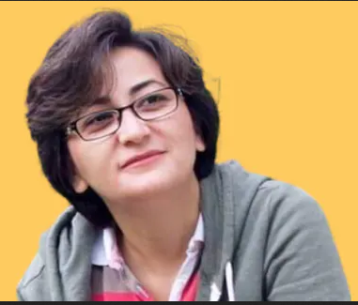






Tools Used for this Study
The Usual
Python Jupyter Requests Numpy Pandas Plotly Wordcloud PIL rasterio skimage geopandas shapely pickle requests BeautifulSoup SimpleHTTP RequestHandler TCPServer Thread newspaper3k urllib regular expressions
The Special
→ embedding
→ clustering
→ topic representations
BERT
UMAP + HDBScan
C-TF-IDF + MMR
BERTopic
(Grootendorst, 2021)
The Very Special

